Slide 1
Research Methodology- Unit 4 Measurement, Scaling and Sampling
Prime College- BIM 6th Semester

Slide 2
Research Methodology- Unit 4 Chapter 5- Sampling
Prime College- BIM 6th Semester

Slide 3
Introduction
A group of similar units of study selected from a population for research is called a sample. Sampling is the process of choosing the sample or formulation of the sample.
Population: All the elementary units in any field of study, i.e., inquiry, are called population. Population refers to the total items or units about which information is desired. The term ‘population’ is referred to as the universe.
Sample: Conducting a census study due to the large size of the population is very difficult because of time limitations, budget limitations, etc. In such conditions, representative units of study are necessary to select from the entire population are selected. Such representative units are called samples.
Sampling: The act of designing a sample for purposeful research is called sampling. This is the process of selecting each element or unit from the population to make the sample representative. It is a rigorous process, as the limitations in this process make the entire research substandard.

Slide 4
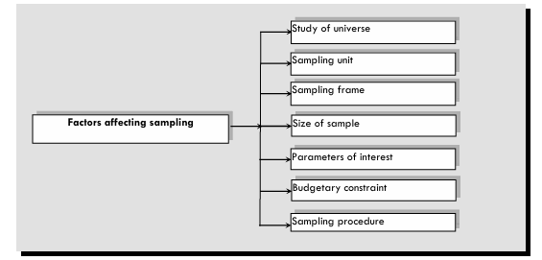
Factors Affecting in Sampling

Slide 5
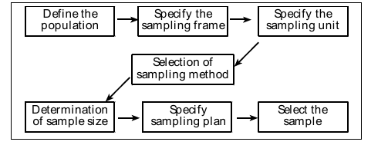
Sampling Process

Slide 6
Factors Affecting the Size of the Sample
Size of population
Homogeneity of population
Accuracy required
Nature of the study
Sampling method
Expected response rate
Resource availability

Slide 7
Advantages of Sampling
Saving time and money
Accuracy in results
Possibilities of intensive study
Administrative convenience

Slide 8
Types of Sampling Method
Probability Sampling or Random Sampling
In this method, every population element is assumed to have an equal chance of being selected in the sample.
Each unit of study is randomly selected so that there is no chance of being biased in selection.
Probability sampling can also be classified into two categories, i.e.,
a) simple random sampling and
b) complex random sampling.

Slide 9
Simple Random Sampling
In this method, each population item has an equal chance or probability of being selected as a sample unit. Simple random sampling is one of the most popular methods of sampling. Simple random sampling may be applied in two ways: without replacement and with replacement. Sampling without replacement means the selected item cannot reappear in the sampling process.
Lottery method: In this method, all items under the study population are numbered or named on separate slips of paper of identical shape and size. These slips are then folded and mixed up in a container. A blindfold selection of the number of slips required to constitute the desired sample size is then made.
Number order method: In the number order method, items under the population are arranged in a particular order and let be specific numbers. Sample units are selected based on particular order like 1, 3, 5, 7… or 5, 10, 15, 20…etc.

Slide 10
Complex random sampling
Complex random sampling is a procedure in which probability and non-probability samples are selected by adopting a particular method. Hence, it is sometimes called mixed sampling. Some valuable methods applicable in complex random sampling are described below
Systematic sampling: Systematic sampling is a method in which samples are formed by selecting one unit at random by applying any one method as described earlier in the simple random sampling method, and then the rest of the units are selected at specific intervals until the desired sample size is met. The sampling interval is determined systematically by applying the following formula:
K = N / n
Where K = Sampling interval, N = Size of the population, and n = Size of the sample
For example, if you are interested in studying 50 individuals out of 500, the sampling interval is 10. While calculating the sampling interval, it is possible to get the fraction value; in such case, if the fraction value is less than 0.5, it should be omitted, and if the fraction value is more than 0.5, it should be taken as 1.
Notes:
https://www.youtube.com/watch?v=UxMxgW4LIms

Slide 11
Complex random sampling
Stratified random sampling:
In stratified random sampling, at first, based on the homogeneity of features in study units within the population, the whole population is subdivided or classified into various mutually exclusive strata covering the whole population.
From each stratum, required samples are chosen using a simple random method.
For example, males and females can be two strata within a population.
After dividing all the study units, sample units from each stratum are selected randomly. The following important issues are common under stratified random sampling:

Slide 12
Complex random sampling
Cluster sampling:
In this method, the basis of forming a sampling unit may be area, location, class, etc.
Suppose the study units are far apart, and it is difficult to identify and locate the sample units in terms of cost, time, and other administrative constraints. In that case, cluster sampling may be an option.
For example, the whole area constituting a defined population can be divided into smaller areas or segments like provinces, regions, etc. After dividing the population into clusters, the required sample units are selected by applying equal or unequal selection probabilities.
Area sampling: If the study elements or units are widely dispersed in various geographical locations, it is impossible to incorporate all units under study, so area sampling becomes useful.
Multi-stage sampling: It is a sampling procedure carried out in several stages. At first, first-stage units are sampled by a suitable method, such as simple random sampling. Then, a sample of second stage units is selected from each of the selected first-stage units, again by some suitable method that may be identical or different from the method employed for the first stage.

Slide 13
Complex random sampling
Sequential sampling:
In sequential sampling, the researcher selects an initial sample based on the appropriate sampling method and then proceeds with further sampling methods within the sample until the final sample is determined.
If information or data generated from this initially selected sample is insufficient, the researcher selects the following sample described above and proceeds again.

Slide 14
Non-Probability Sampling
Non-probability sampling is a technique in which sampling elements are selected without assuming an equal chance for each study unit to select into the sample.
This method is also known as non-random sampling.
Non-probability sampling methods are those in which each study unit does not have an equal possibility of being selected as a sample unit.
Methods of Non-probability sampling are:
Purposive Sampling
Quota sampling
Convenience sampling
Self-selecting sampling
Snow-ball sampling

Slide 15
Non-Probability Sampling
Purposive Sampling:
Purposive sampling is also known as judgmental or deliberate sampling.
In this method, the choice of sample units exclusively depends on the judgment or objective of the researcher.
The researcher uses their judgment in the choice of sample units.
The researcher includes those units in the sample most typically representative of the population.
For example, if the researcher is interested in using content analysis regarding gender, then the researcher may select famous women's magazines or journals published with gender themes.

Slide 16
Non-Probability Sampling
Quota sampling:
In quota sampling, the researcher first identifies relevant population categories and determines quotas based on specific characteristics.
For example, in research on brand choice of mobile set to estimate the influence of age group, age categories can be formed as - below 20, 20 - 30, 30 – 40, 40-50, and so on. Then, the researcher is advised to take the responses of 100 respondents from each category as defined.
The selection of respondents or units solely depends on the personal judgment of the researcher.
As a drawback of quota sampling, it becomes difficult to get representative sample units due to the risk of personal bias.
Quota sampling is a commonly used sampling technique in non-random sampling

Slide 17
Non-Probability Sampling
Convenience sampling:
This method selects sample units from the convenient population units per the researcher's convenience.
In this method, sample units are selected neither by probability nor judgment but only by convenience.
In the convenient sampling method, there is a high chance of personal bias, and it is hardly representative of the population.
However, this sampling method is more appropriate if the time and resource constraint is high.

Slide 18
Non-Probability Sampling
Self-selecting sampling:
In this method, the investigator publicly announces to join as a sample unit for research through mass media like Television, Radio, Newspapers, e-mail, internet, website, etc.
Interested individuals may join as a sample unit, i.e., respondents or informants for the research study.
This method is easy and less costly.
The validity and reliability of the findings of research work conducted with this method are very low because of the poor representativeness of the sample units.

Slide 19
Non-Probability Sampling
Snow-ball sampling/ Referral or reputational sampling:
Snow-ball sampling is the method that begins with the identification of one respondent at first.
Then, based on information from the first respondent, the researcher identifies other respondents.
The exact process is repeated again and again until the desired sample size is not obtained.
It is widely used in crime investigation, social research like drug addiction, prostitution, and the severity of socially excluded diseases like AIDS, etc., where respondents do not want to be open, and the researcher cannot directly approach them.
It is based on an analogy to a snowball, which begins with a small piece and then gradually gets more extensive as it picks up additional snow.
This method is sometimes also called network chain referral or reputational sampling.

Slide 20
Rules to Fix Sample Size
Sample sizes greater than 30 and less than 500 are appropriate for most research.
If the sample study is to be made on sub-sample, i.e., categories like male/female, senior/junior, pass/fail, etc., the sample should contain at least 30 units from each category or sub-sample, i.e., 30 each from male and female, total sample size of 60.
In multivariate research, including multiple regression analysis, the sample size should be several times, i.e., preferably ten times or more, as large as the number of variables in the study.
For simple experimental research with tight experimental control, a sample size as small as ten to twenty will be most appropriate for good results. If the dispersion, i.e., variance, is more excellent within the population units, a large sample as much as possible is desired to get the result more precisely.
Notes:
https://www.youtube.com/watch?v=GyW2FYhyBLI

Slide 21
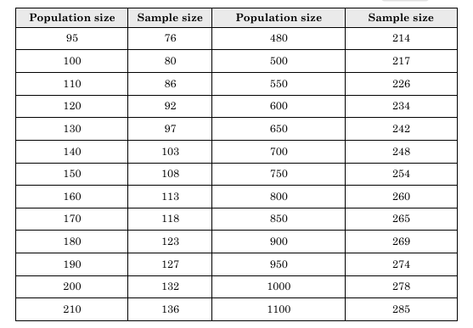
Rules to Fix Sample Size
Notes:
https://www.youtube.com/watch?v=GyW2FYhyBLI

Slide 22
Sampling and Non-Sampling Errors
Sample errors are errors that cannot be avoided absolutely while making a sampling decision.
Only limited or selected study units are considered under the sampling technique, which increases the chances of increasing non-representativeness.
This increases the chances of getting wrong, less reliable, and less valid results.
Such errors encountered with the application of sampling are termed sampling errors.

Slide 23
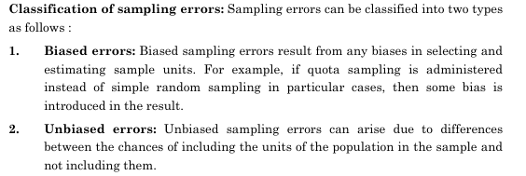
Sampling Errors
Sampling error is the difference between sample results (statistics) and the population parameters.
Even if more excellent care has been taken in selecting a sample, the results generated from a sample study may not precisely match the actual value in the population.
The estimate is based on a part rather than the whole population.

Slide 24
Approaches for Minimizing Sampling Errors
Increasing the sample size
Triangulation
Use of unbiased sampling
Revising question design
Adoption of a strong sampling plan

Slide 25
Non-Sampling errors
Non-sampling errors can be defined as errors arising during research rather than resulting from the sampling procedure.
Non-sampling errors can occur because of problems in coverage, response, non-response, data processing, estimation, and information analysis.
Unlike sampling errors, there is no simple and direct method of estimating the size of non-sampling errors.
Unlike sampling error, increasing the sample size will not affect reducing non-sampling error.
Significant non-sampling errors can be explained as below:
Over-coverage error: Including data from outside the population increases the error.
Under-coverage error: Under-coverage errors can be increased if the sampling frame does not include appropriate elements from the population.
Measurement error: The respondent misunderstands the question due to a poor questionnaire, an untrained enumerator, or due to the low awareness level of respondents.

Slide 26
Non-Sampling errors
Over-coverage error: Including data from outside the population increases the error.
Under-coverage error: Under-coverage errors can be increased if the sampling frame does not include appropriate elements from the population.
Measurement error: The respondent misunderstands the question due to a poor questionnaire, an untrained enumerator, or due to the low awareness level of respondents.
Processing error: Mistakes in data coding, editing, processing, analyzing, and interpretation of the finding also create errors. Such errors are termed as processing errors.
Response error: No response, biased response, inability to response/answer, cheating the response of others, unwillingness to respond, misinterpretation of the question as well as response, response conceived and recorded incorrectly, the inadequacy of response collected as per required to valid and reliable interpretation, incompleteness of response, poor questionnaire, etc. are the source of response error.

Slide 27
Non-Sampling errors
Researcher error: No clear definition, selection of wrong variables, selection of wrong method, poor questionnaire, improper administration of the questionnaire, intentional errors, interpretation errors, etc., are the source of researcher error.
Field worker/enumerator error: Biases, misinterpretation of questions, poor interview, weak inclusion, and rapport, intentional errors of field workers and enumerator also create the errors termed field worker/enumerator error.

Slide 28
Approaches for Minimizing Non-sampling Errors
Careful population selection
Be careful while developing a questionnaire
Be careful while interviewing
Ensuring confidentiality and anonymity of respondents
Selection of well-experienced, skilled, knowledgeable, and trained researcher
Rechecking the data entry and processing

Slide 29
End of Chapter 5
(Click the arrow when in Slide Show mode)
Notes:
In Slide Show mode, click the arrow to enter the PowerPoint Getting Started Center.

